Slide 1
ESG Methodology and the Current Market scenario
CS F366: DESIGN PROJECT: NLP TECHNIQUES IN ESG
Presented By:
Rishabh Patil
2021A7PS0464H

Slide 2
What is ESG?
Environmental (E): Refers to the impact a company has on the environment, including factors like carbon emissions, waste management, and resource conservation.
Social (S): Covers a company's relationships with employees, suppliers, customers, and communities. Key factors include labor practices, diversity, human rights, and community impact.
Governance (G): Involves the internal practices and policies of a company, including executive pay, audits, internal controls, and shareholder rights.
Importance of ESG:
Risk Management: ESG factors help companies manage risks that can impact their long-term sustainability.
Value Creation: Companies with strong ESG practices can build brand loyalty, attract better talent, and innovate more effectively.

Slide 3
ESG Investing in Recent Times
Trends in ESG Investing:
Mainstream Adoption: ESG investing has moved from niche to mainstream, with large asset managers like BlackRock integrating ESG into their investment processes.
Thematic Investing: Growth in thematic funds focusing on specific ESG issues, such as clean energy, water sustainability, or gender equality.
Performance of ESG Investments:
Resilience in Crises: ESG funds have shown resilience, particularly during the COVID-19 pandemic, outperforming traditional funds.
Long-term Outperformance: Studies suggest that companies with strong ESG practices often deliver better long-term financial returns.
“Global ESG assets surpassed $30 trillion in 2022 and are on track to surpass $40 trillion by 2030”
-Bloomberg, Feb 2024

Slide 4
The Big 3 (ESG Rating Agencies)
MSCI ESG Ratings
Morningstar Susatainlytics
LSEG Refinitiv
All Three agencies have different (unregulated) methodologies and rating metrics:

Slide 5
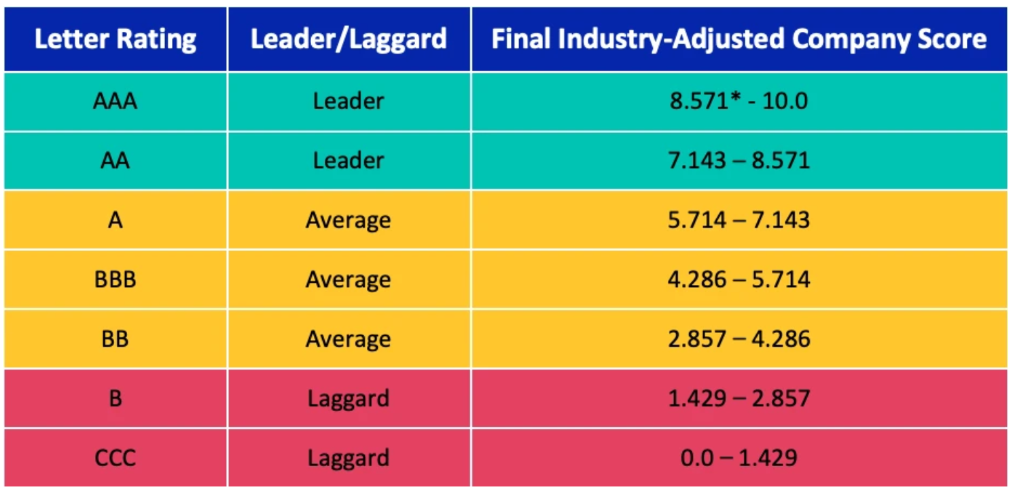
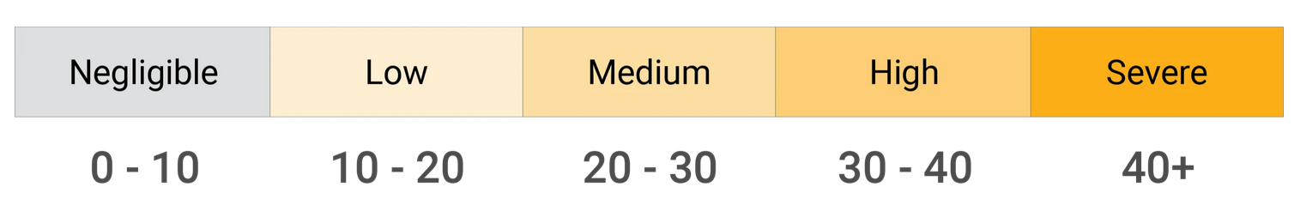
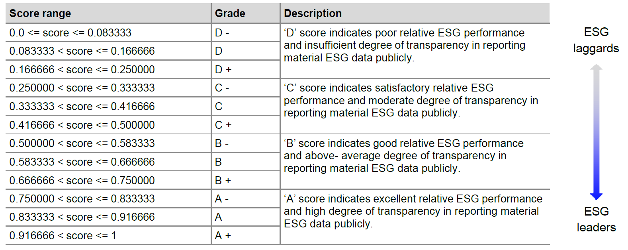
MSCI ESG Ratings
Sustainilytics
LSEG Refinitiv

Slide 6
High Level Overview of the Score Computation
Data Sourcing
Gather data from the company’s annual report, CSR reports, and news outlets, all of the data used is publicly available, though the sourcing is done directly through company and some third party non-interest-conflicting sources.(different agencies use different data points)
Quantifying and aggregating Available Data
Follow set and declared methodology rules(vary agency to agency) to quantify(some) data and aggregate to common variables(categories).
3. Divide company(of which the score is being computed) into distinct category and assign weights to each category accordingly.
4. Calculate Final Scores based on the category weights and Compute a final comparable score.

Slide 7
Detailed Methodology
According to LSEG Refinitiv

Slide 8
Refinitive uses 70-170 data points per company out of ~500 data points’ pool based on the company categorization.
Company Categorization(TRCB) Description of all the data point variables used
There are 10 broad categories that Refinitiv defines:
Environmental |  |  | Social |  |  |  | Governance
Emission | Innovation | Resource Use | Human Rights | Product Responsibility | Workforce | Community | Management | Shareholders | CSR Strategy
Each category consists of numerous data points and a simple sum is taken to compute category score. Each data point score is calculated as follows:
Working example
These categorical scores are then multiplied with the categorical weights(according to materiality matrix – which depend on the TRCB company classification)

Slide 9

Categorical Weights are decided based on sector by LSEG(process not disclosed)
These category weights are then normalized wrt to E/S/G thus forming pillar weights.
Final score:
$$f_{X_{C}}=\sum_{cat_{i}}{x_{j}}\left(pw_{j,i}\right) | x_{j}∈X_{C}$$
Working Example

Slide 10
Role of Frameworks(GRI and SASB)
ESG Frameworks are structured guidelines and standards that companies use to disclose information about their sustainability and ethical practices.
GRI(Global Reporting Initiative) and SASB(Sustainability Accounting Standards Board) are two leading sustainability reporting standards, each serving different audiences. GRI focuses on a broad range of stakeholders, including communities, employees, and customers, while SASB is primarily investor-focused and emphasizes financial materiality
GRI provides a broad view of a company’s impact on the environment, society, and economy, while SASB narrows down on industry-specific financial impacts.
One of the central issues of the ESG ratings is the use of varied data that rating agencies use resulting in irregular ratings. With companies complying to GRI and SASB, the data reported by companies is structured and allows less room for (deliberate) deviation.
How companies comply to GRI and SASB

Slide 11
Role of Frameworks(GRI and SASB) …for Rating Agencies
The use of ESG frameworks by rating agencies ensures that their evaluations are grounded in accepted global standards, making the ratings more reliable for investors seeking to make informed decisions.
Why Does the Issue Still Persist? (TLDR: The Materiality Matrix)
Financial materiality refers to the relevance and significance of a specific issue, event, or piece of information to the financial performance of a company/industry.
Materiality matrices used by different rating agencies are not regulated by a single overarching framework. Instead, they are typically developed by the rating agencies themselves.
Many agencies draw guidance from established ESG frameworks and standards. For instance:
SASB,GRI,TCFD
While these frameworks provide valuable guidance, rating agencies are not required to strictly follow them, and they often modify or adapt these standards to fit their own rating models.
Some agencies might offer detailed explanations of their materiality matrices, while others may provide only a high-level overview, keeping specific weightings and criteria proprietary.

Slide 12
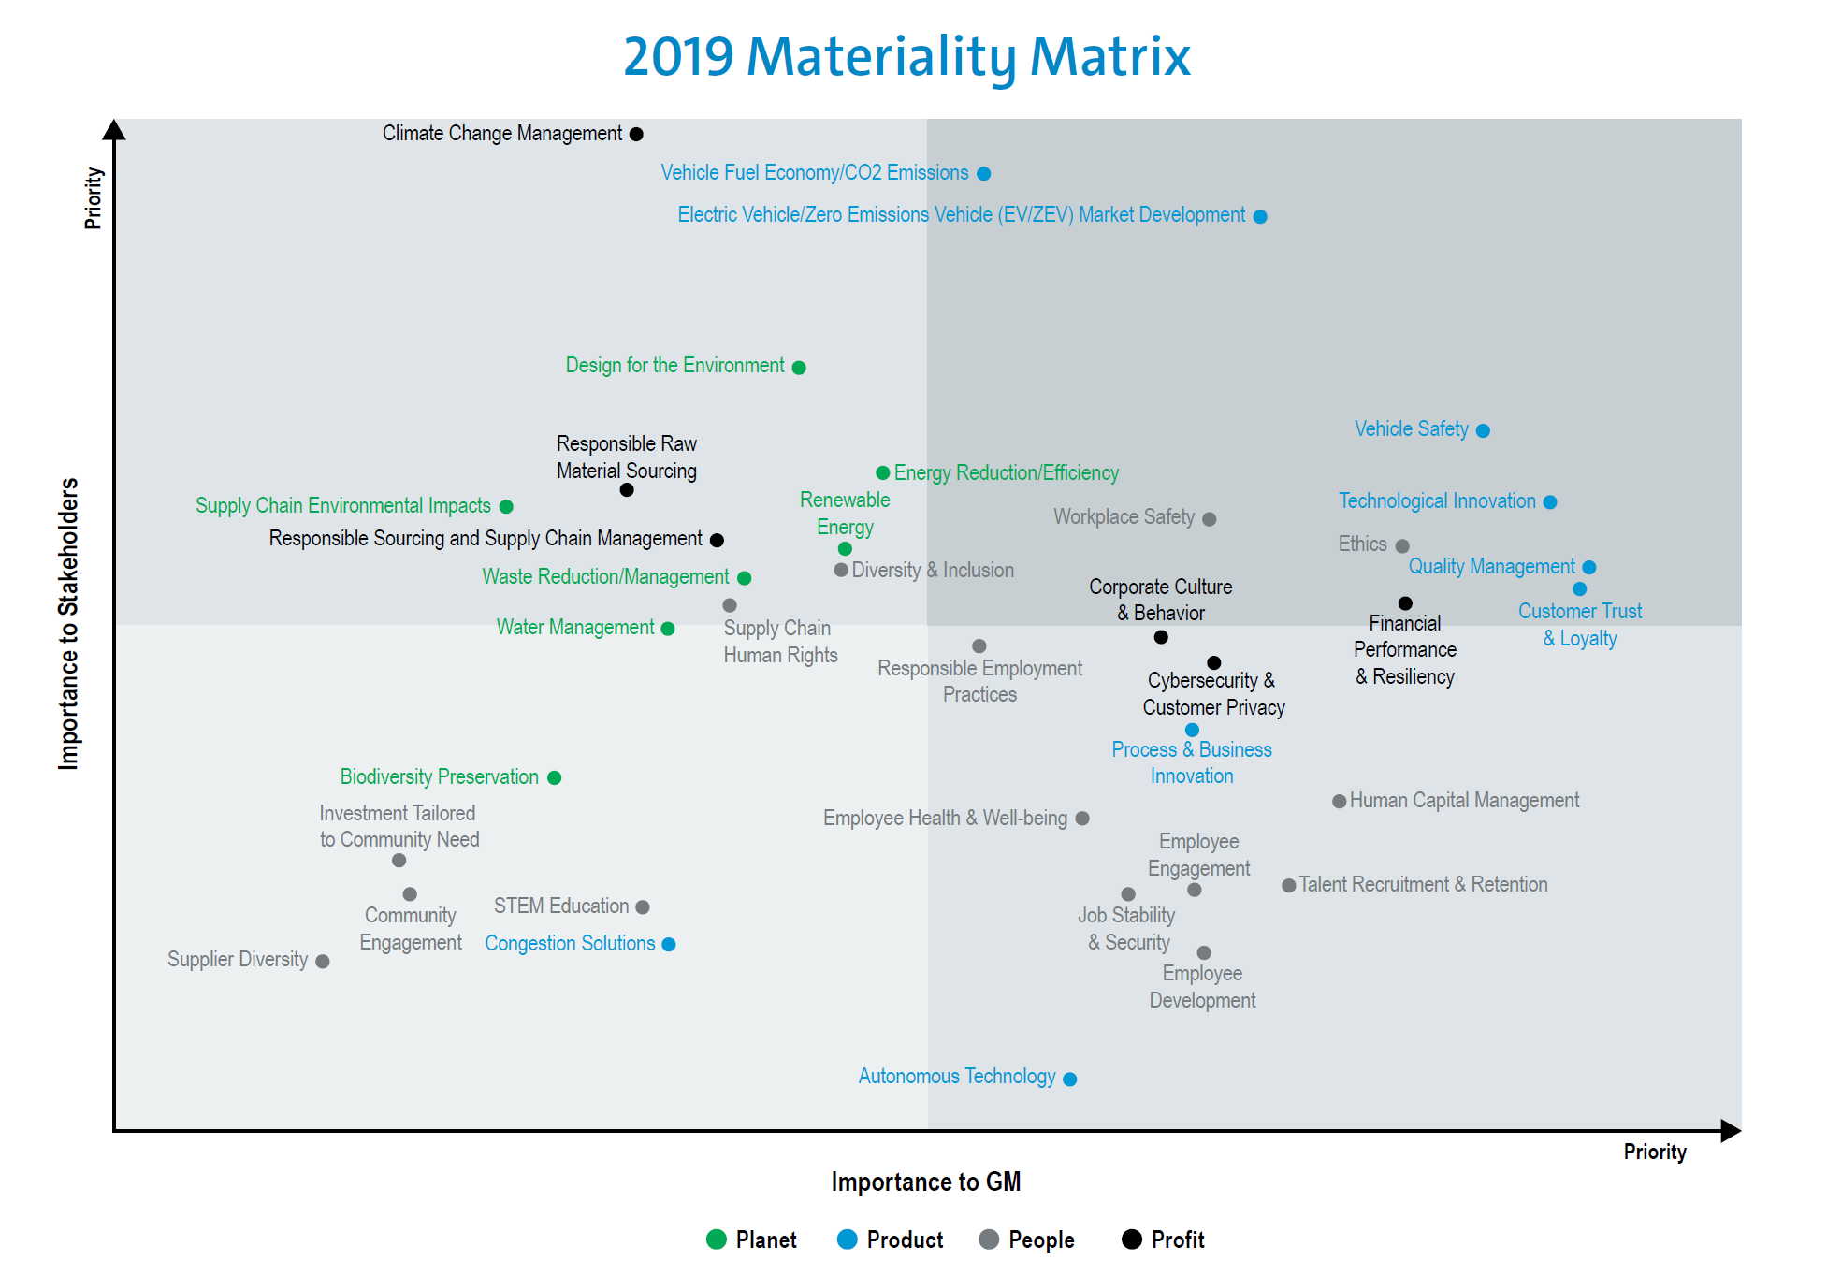

Slide 13
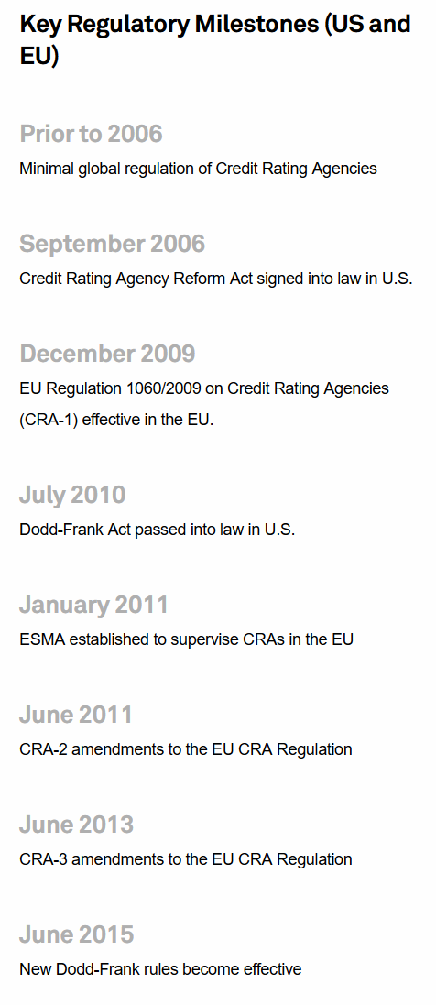
Comparison to Corporate Credit Ratings
On the surface level, ESG ratings and Corporate Credit Ratings look almost synonymous in terms of reporting.
But, for the credit ratings there is a defines metric, i.e: Probability of Default, whereas ESG seems still less clear.
Lack of Regulations.
Lack of Proper Reporting and goal based assessment

Slide 14
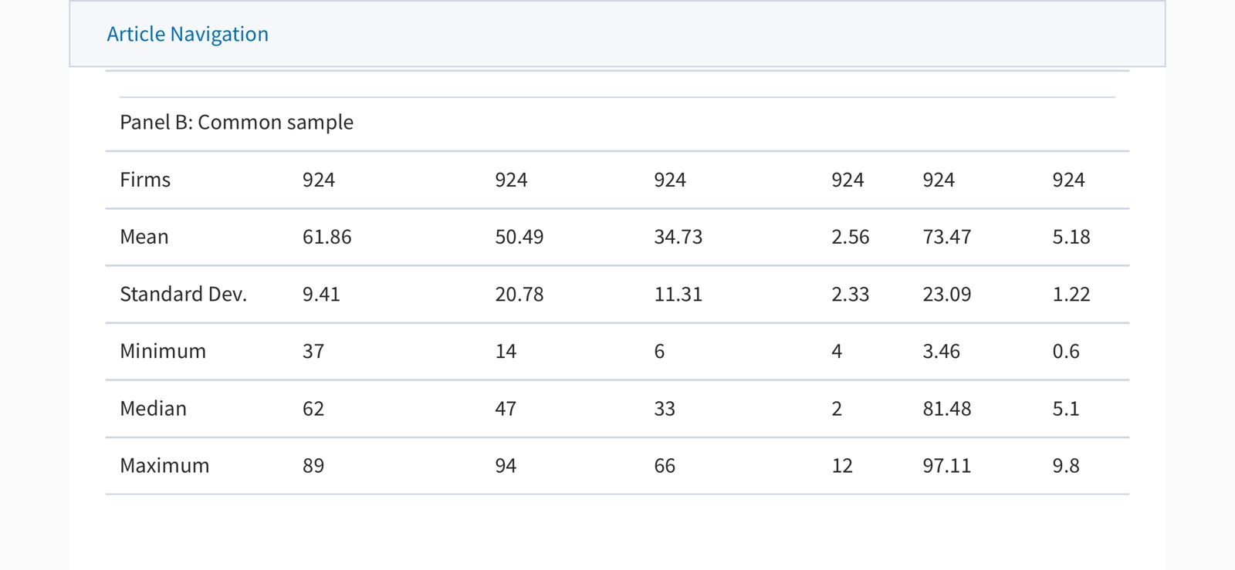

Slide 15
Scope of Our Study
Working on regulated data and data processing
Trying to shape pre-existing reports into regulatory formats
Unique and data based approach to the materiality matrix – lots of variables into play
(Maybe trying to merge a few frameworks)

